Slide 1
c-di-GMP and the flagellar motor

Slide 2
The E. coli flagellar motor
MotA/MotB
FliG
FliM
FliN
Taken from various articles

Slide 3
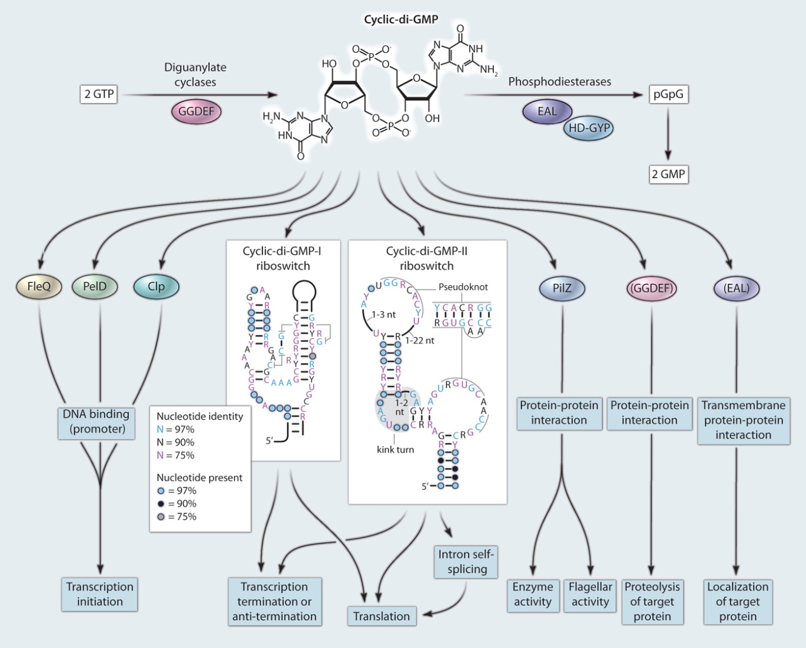
c-di-GMP effectors and effects
YhjH
Effector
YcgR
Target
Hengge R, Sci Signal, 2010
YhjH and YcgR are components of the flagellar regulon
Wang et al. 2006

Slide 4
Elevated c-di-GMP levels inhibit motility and chemotaxis
Wild -Type
ΔyhjH
Salmonella
E. coli
c-di-GMP
YhjH is the strongest PDE in E. coli and Salmonella
Vince Nieto

Slide 5
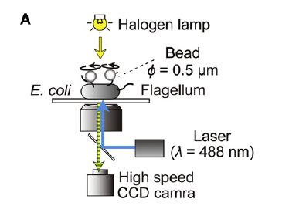
Single Motor Bead Assay
E. coli with “sticky” filaments bind polystyrene beads.
High-speed camera captures beads attached to the sticky filament.
Video data processed to give rotation speed (Hz) and rotation direction (CCW, CW, stop).
(Berry et al., 2003, Terasawa et al., 2011)

Slide 6
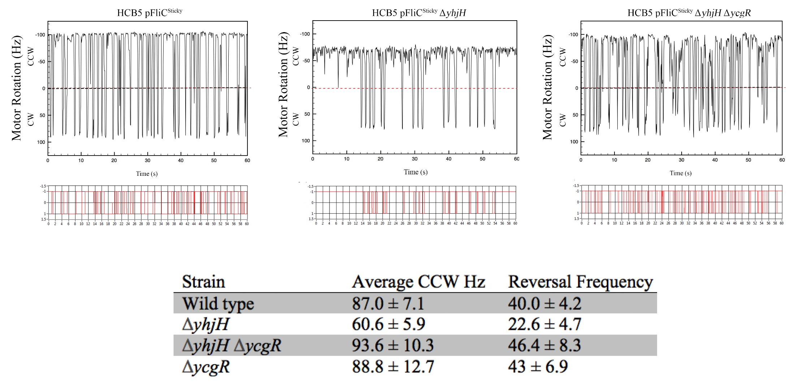
E. coli yhjH mutant has a simultaneous reduction in speed and reversals

Slide 7
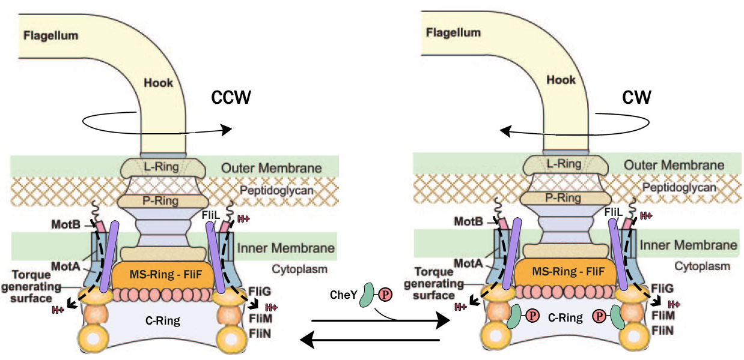
YcgR::c-di-GMP interacts with the flagellar rotor
CW
CCW
CCWCCWC
CCW/Slow
YcgR::c-di-GMP
Blair-Harshey, Mol Cell 2010

Slide 8
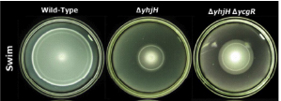
Deletion of YcgR does not restore wild type motility levels
Think of possible explanations

Slide 9
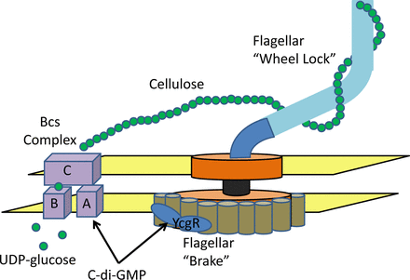
Cellulose synthase BcsA affects motility in Salmonella
(Waters, 2013; Zorraquino et al., 2013; Unpublished Data)

Slide 10
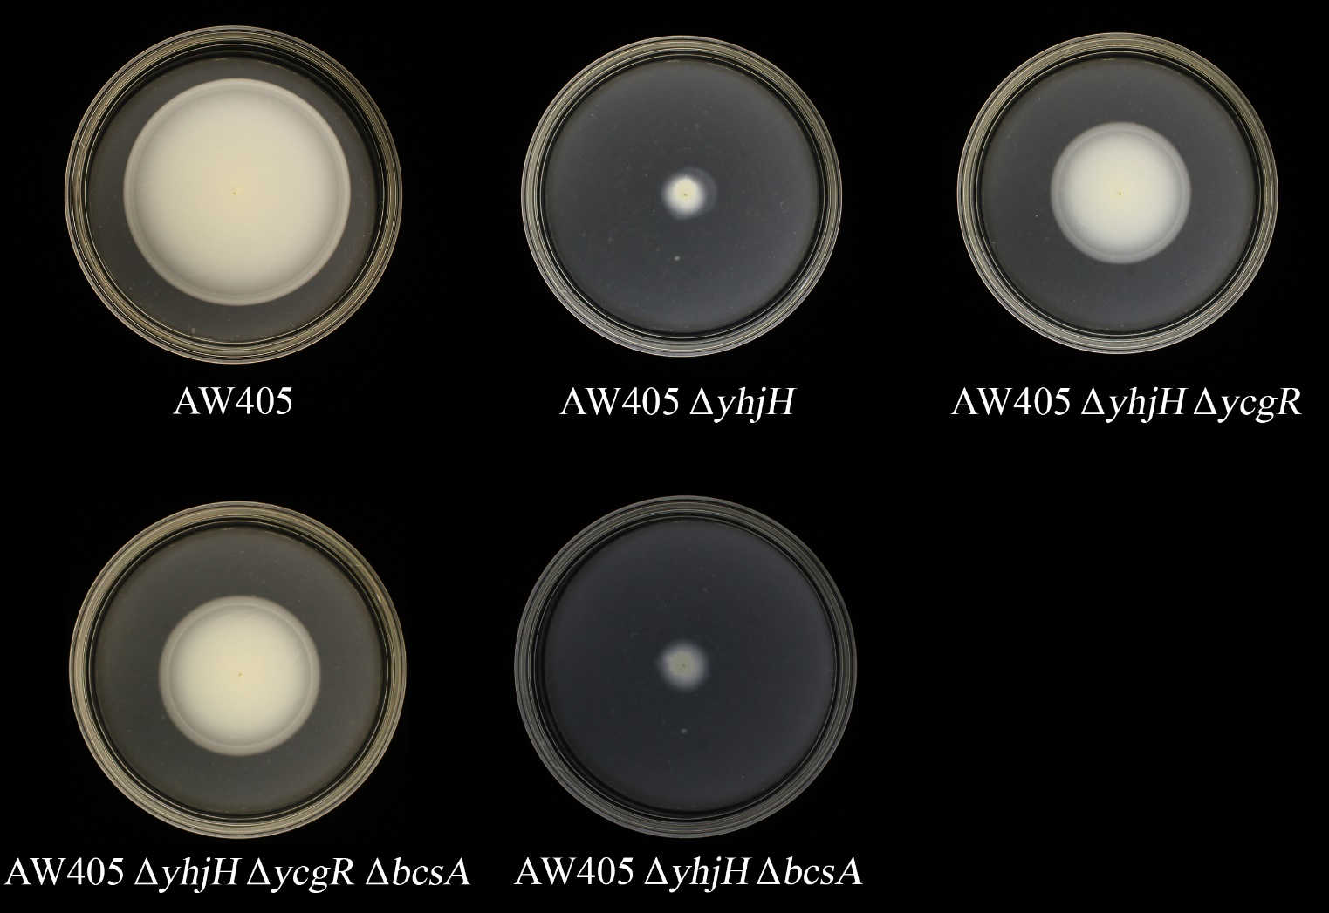
E. coli BcsA does not inhibit motility in agar assays
Deletion of all known biofilm pathways fails to restore wild type motility to ΔyhjHycgR,
suggesting a new mechanism for motility inhibition

Slide 11
How might YcgR::c-di-GMP skew motor bias to CCW and slow the motor?
CW
CCW
CCWCCWC
CCW/Slow
YcgR::c-di-GMP
Blair-Harshey, Mol Cell 2010

Slide 12
How YcgR::c-di-GMP interacts with the flagellar rotor
Blair-Harshey model
Mol Cell 2010
YcgR was observed to interact with FliM and FliG in the C ring, but not with Mot proteins

Slide 13
‘Backstop Brake’ model for motor control by YcgR

Slide 14
YcgR::c-di-GMP: a different observation of how speed is reduced
Blair-Harshey model
Jenal saw a FRET signal between
YcgR and MotA, but not FliM/FliG
MotA suppressors map to
MotA-FliG interface, and have
lost FRET interaction with YcgR
Jenal model
Cell 2010

Slide 15
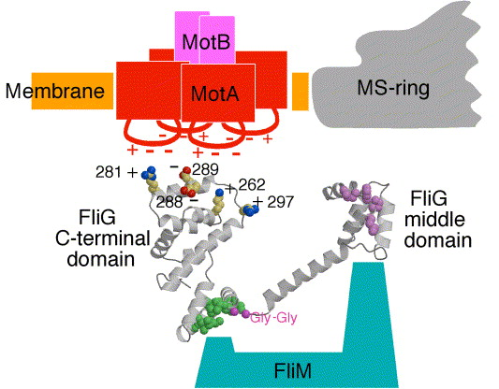
1. Motor speed and bias of MotA supressors
The Jenal model says that YcgR^{c} binds to MotA to disrupt MotA-FliG interaction and hence proton flow.
Prediction: MotA suppressors that lose YcgR^{c} binding, likely restore normal MotA-FliG interaction. Speed and bias return to normal.
The B-H model says that YcgR^{c} binds to FliM, destabilizes FliG, and disrupts MotA-FliG interaction.
Prediction: MotA suppressors strengthen MotA-FliG interaction, preventing YcgR^{c} from destabilizing FliG. Strengthened MotA-FliG might not restore speed. However, since bias is dictated by FliM, which can still interact with YcgR, bias may be unaffected.
WT yhjH MotA^{S96L}

Slide 16
Tests to distinguish between/reconcile the two models
1. Motor speed and bias of MotA supressors
2. MotA-YcgR FRET signal in FliG mutants that don’t bind YcgR

Slide 17
MotA supressors restore bias but not speed
John Partridge
WT yhjH MotA^{S96L}

Slide 18
2. MotA-YcgR FRET signal in FliG mutants that don’t bind YcgR
The Jenal model says that YcgR^{c} binds to MotA to disrupt MotA-FliG interaction
Prediction: There should be a positive FRET signal in FliG mutants in the charged ridge that don’t bind YcgR
The B-H model says that YcgR^{c} destabilizes FliG, and disrupts MotA-FliG interaction.
Prediction:There should be no FRET signal in FliG mutants in the charged ridge that don’t bind YcgR

Slide 19
Two models for how speed is reduced by YcgR::c-di-GMP
Blair-Harshey model
Jenal model

Slide 20
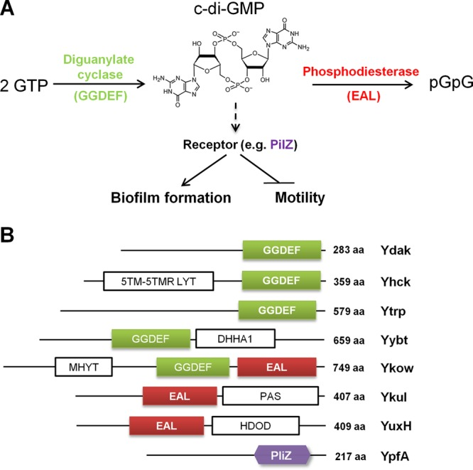
Bacillus c-di-GMP proteins
Swarming assay
YcgR
YhjH
Chen et al. 2012

Slide 21
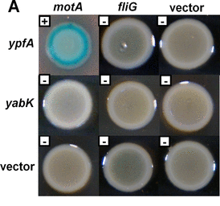
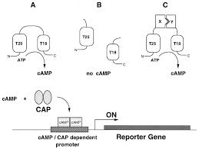
Bacillus YfpA interacts with MotA
Two-hybrid assay
Chen et al. 2012

Slide 22
The flagellar motor is a sensor

Slide 23
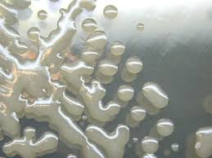
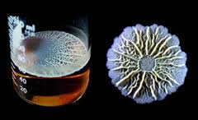
Extracellular polysaccharides (EPS) promote stickiness
or Biofilms
PGA
EPS

Slide 24
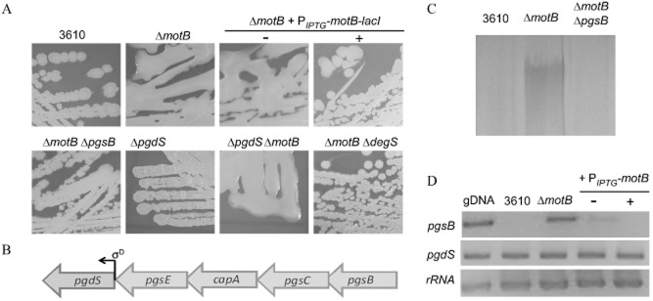
Mutations in the stators (MotAB) or a flagella-associated TCS
(DegSU) increase PGA synthesis in Bacillus subtilis
WT
Methylene blue stained
RT-PCR
pgsB operon controls PGA (polyglutamic acid) synthesis
pgdS is driven by a separate promoter and is not involved in PGA synthesis
Cairns et al. 2013

Slide 25
DegSU monitors motor conformation, and relays the information to the genome
DegSU
HK
RR

Slide 26
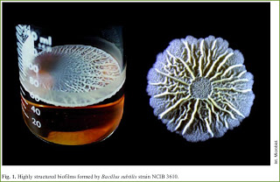
A twist in the tale: A molecular clutch disables the B. subtilis motor in a biofilm
Blair et al. 2008
Pellicle
Crinkled colony

Slide 27
Bacillus subtilis EPS operon
SinR governs the alternate regulation of motility and biofilm formation by inhibiting
expression of the eps operon
SinR mutants overexpress EPS and are non-motile – because they are sticky?
(Blair et al. 2008)

Slide 28
Motility inhibition is not due to biofilm matrix
sinR-epsH double mutant does not make matrix - but is still non-motile
Motile suppressors of the sinR-epsH double mutant mapped epsE

Slide 29
Model: EpsE acts as a clutch
A. SinR governs the alternate regulation of motility and biofilm formation by inhibiting
expression of the eps operon. During biofilm formation, the operon expresses both the
biofilm matrix and EpsE, a motility inhibitor.
B. EpsE disrupts FliG-MotA interaction.

Slide 30
Benefits of the clutch/break
Fast. Needs only EpsE/YcgR to stop motility
No need to get rid of flagella immediately, as they are expensive to make
If the biofilm thing doesn’t work out, can fall back on flagella to swim out again

