Slide 1
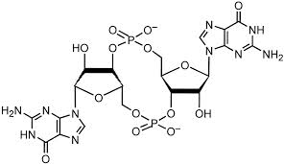
c-di-GMP signaling: Biofilms

Slide 2
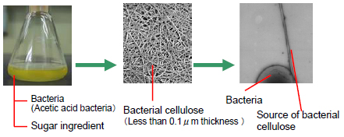
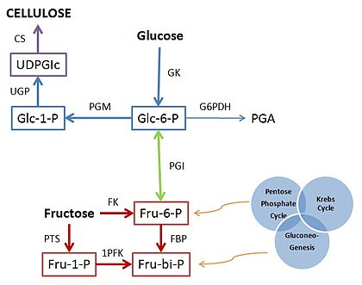
Background
c-di-GMP first identified in 1987 as allosteric regulator of
cellulose synthase BcsA in Gluconacetobacter xylinum
BcsA

Slide 3
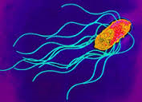
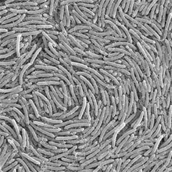
c-di-GMP
Stick or Swim
Motility
Biofilms
3

Slide 4
REC
PAS
GAF
HAMP
GGDEF
EAL
HD-GYP
2 GTP
2 GMP
Diguanylate cyclase
DGC
Phosphodiesterase
PDE
Effectors
Proteins / RNA
Target

Slide 5
Signals perceived include oxygen and redox conditions, light, starvation and various extracellular substances, such as antibiotics, polyamines or intercellular signaling molecules.

Slide 6
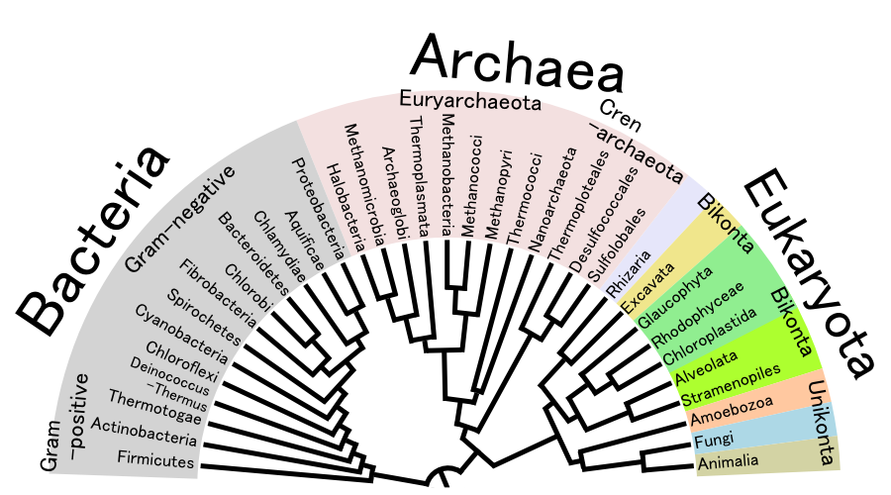
GGDEF and EAL are the most abundant domains,
found only in Eubacteria
Largest numbers in Vibrio cholera: 60/30
Salmonella typhimurium: 12/14
Helicobacter pylori: 0

Slide 7
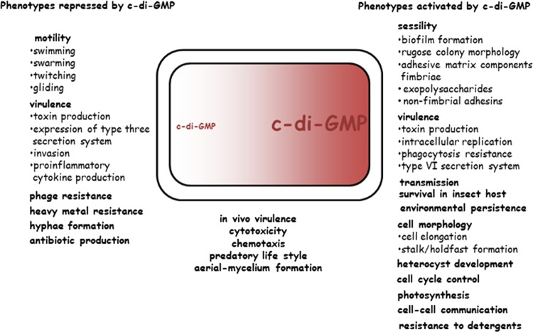
Cyclic di-GMP: the first 25 years
c-di-GMP
Romling et al MMBR 2013

Slide 8
Although c-di-GMP was identified as an allosteric regulator of BcsA, the connection
between the ubiquitious GGDEF motif and c-di-GMP synthesis was made first in
Caulobacter PleD
c-di-GMP first identified in 1980s as allosteric regulator of
cellulose synthase BCA in Gluconacetobacter xylinum
BcsA

Slide 9
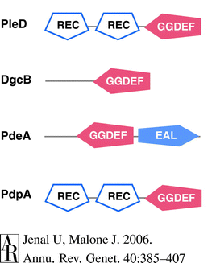
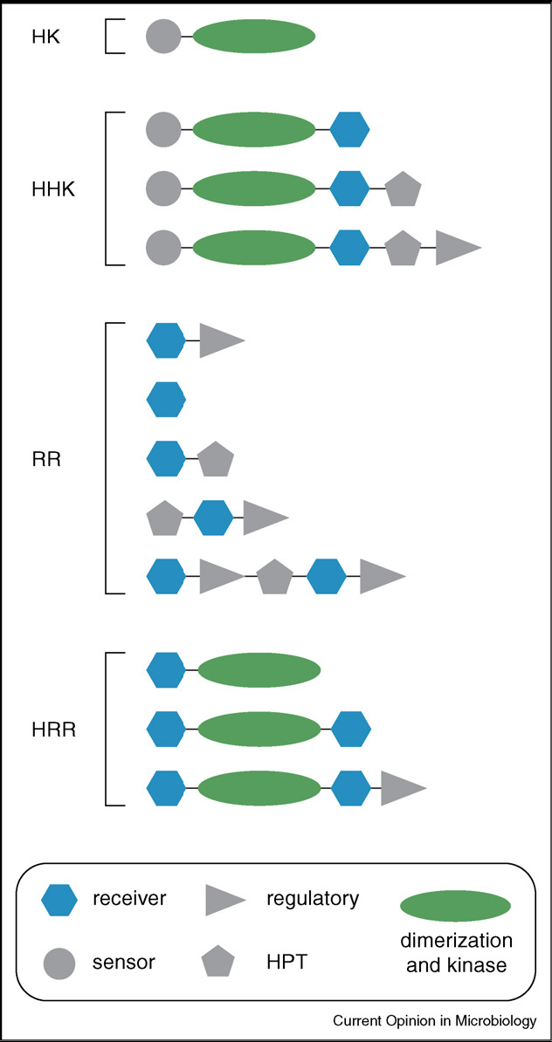
Caulobacter GGDEF proteins linked to TCS REC domains
Phosphorylation of Rec
activates DGC
BcsA

Slide 10
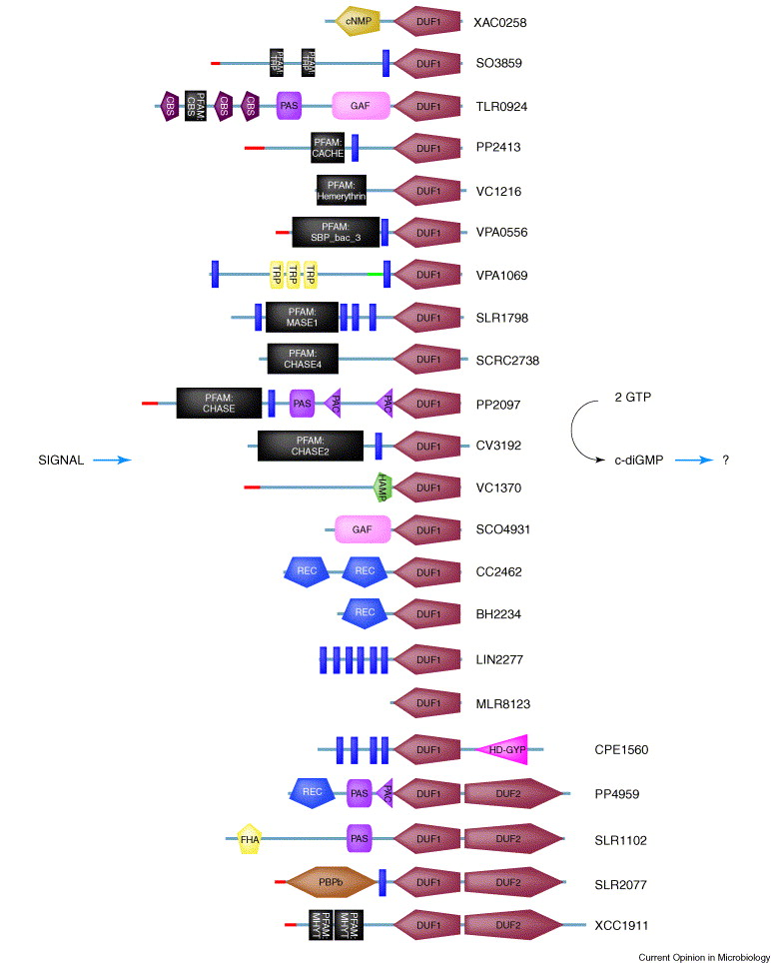
A variety of input sensor domains

Slide 11
REC
PAS
GAF
HAMP
GGDEF
EAL
HD-GYP
2 GTP
2 GMP
Diguanylate cyclase
DGC
Phosphodiesterase
PDE

Slide 12
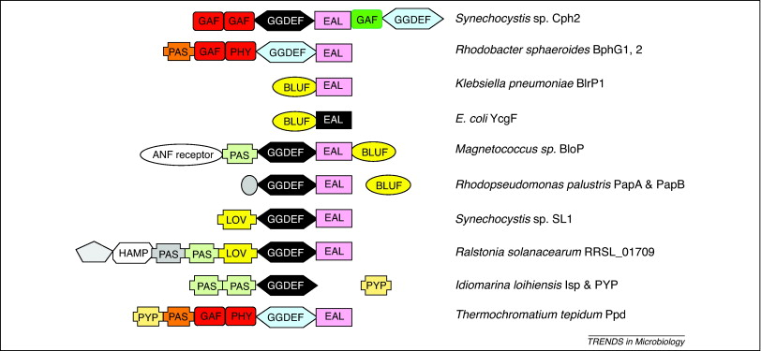
Hybrid GGDEF/EAL proteins
Some have retained only one or the other activity, some have lost both, and can be identified by ‘degenerate’ consensus

Slide 13
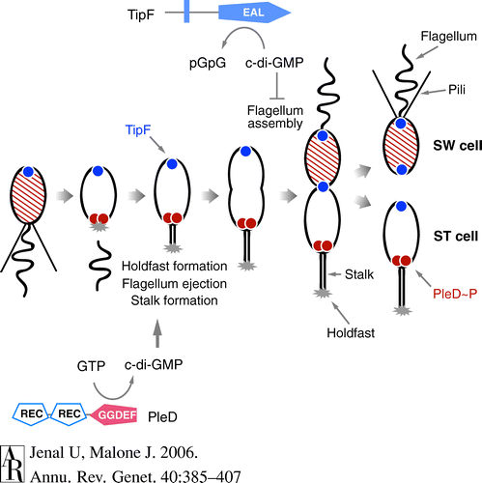
PleD~P in response to surface signals generates c-di-GMP
in Caulobacter to promote holdfast formation
Surface attachment/
Slow motor are signals
RR
DivJ and PleC are polar
Kinases involved in
phosphorylation of PleD
Gain of motility in swimmer cells requires low ci-di-GMP

Slide 14
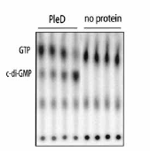
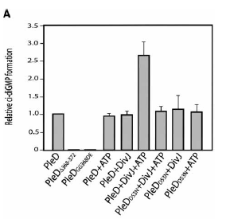
The output domain of PleD is in its GGDEF domain
Phosphorylation of PleD by DivJ kinase, and an intact
GGDEF domain of PleD, are both required for c-di-GMP synthesis

Slide 15
GTP promotes dimerization of PleD
How c-di-GMP promotes flagella ejection
is unknown

Slide 16
II. Wsp chemosensory pathway of Pseudomonas senses surface signals
to make c-di-GMP : Biofilms
The Wsp chemosensory pathway is homologous to the chemosensory system in E. coli, except it suppresses motility and promotes biofilm formation. In this model, WspE kinase activity is activated via signal-dependent conformational changes in the WspA/WspB or WspA/WspD complex. WspE phosphorylates WspR. FleQ activates flagella expression and represses EPS expression. C-di-GMP inactivates FleQ, relieving inhibition of exopolysaccharide synthesis.
Adaptation to external signals is mediated by the phosphorylation-dependent methylesterase activity of WspF and the methyltransferase WspC.

Slide 17
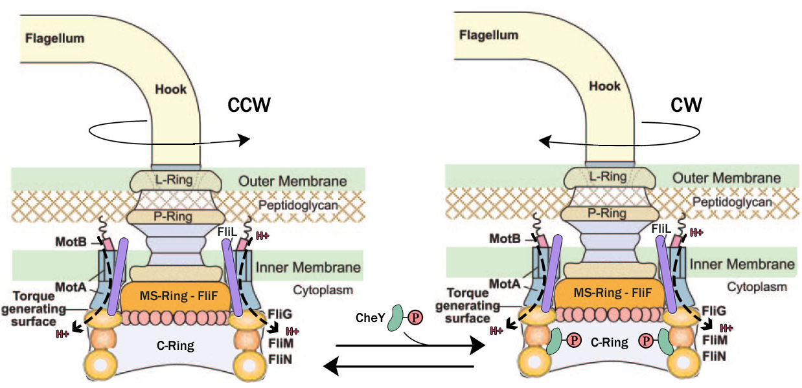
III. YcgR-ci-di-GMP acts at the switch complex to inhibit motility
in Salmonella/E. coli
CCWCCWC
CCW/Slow
YcgR::c-di-GMP

Slide 18
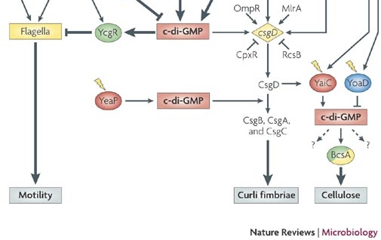
Motility is also arrested in biofilms synthesized in response to c-di-GMP
PGA
In E. coli, c-di-GMP induces adhesive curli fimbriae, cellulose and PGA
and shuts down motility

Slide 19
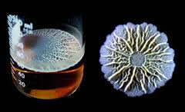
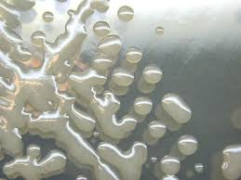
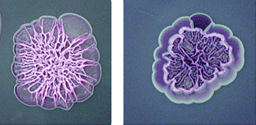
Extracellular polysaccharides (EPS) promote stickiness or Biofilms
Cellulose + Fimbrae
Congo Red dye plates

Slide 20
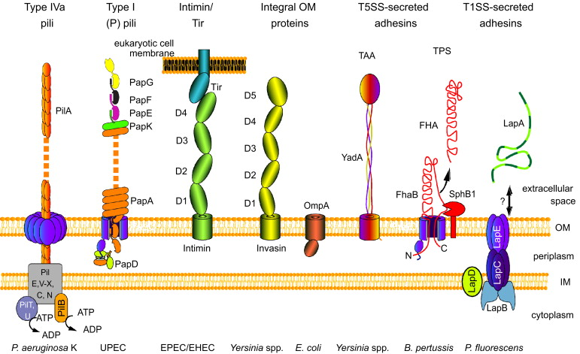
IV. C-di-GMP promotes adhesin (LapA) synthesis in Pseudomonas fluorescens
Major classes of adhesive protein assemblies present on the surface of Gram-negative bacteria
R. G. Gerlach & M. Hensel 2007 IJMM

Slide 21
LapD is a degenerate, enzymatically inactive GGDEF/EAL domain protein
Pseudomonas fluorescens
LapD can bind c-di-GMP via
degenerate EAL domain

Slide 22
Inside-Out signaling mechanism
Conformational changes in the intracellular domain of LapD regulates the conformation of its periplasmic output domain, which differentially interacts with a protease, LapG, that in turn controls the stability of the cell surface LapA adhesin, and hence biofilm formation. LapG is
sequestered when LapD is activated, allowing LapA to anchor in the OM

Slide 23
Mutation of LapD, allows secretion but not attachment of LapA

Slide 24
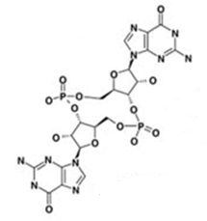
cyclic-di-GMP
DGCs
PDEs
2 GTP
pGpG
c-di-GMP
Biofilm
Motile lifestyle – Free living
Sessile lifestyle – Attached to surface

Slide 25
YfiN controls cell division in response to envelope stress in E. coli
V. Regulation of cell-division in E. coli: New role
Hyo Kyung Kim

Slide 26
YfiN as a c-di-GMP synthetic enzyme
DGCs
BcsA
YcgR

Slide 27
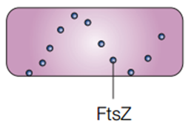
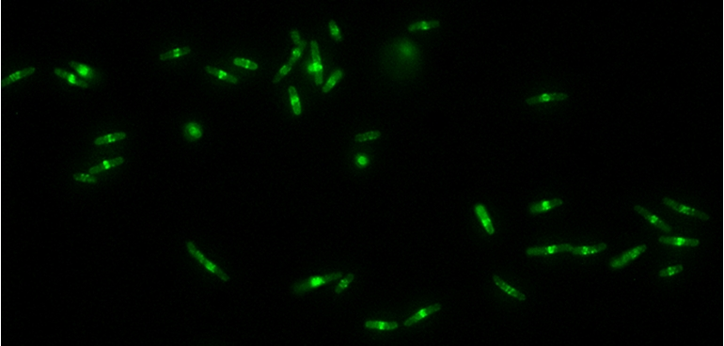
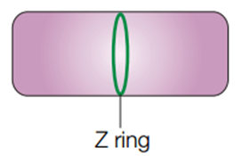
YfiN localizes to the midcell with protein FtsZ and inhibits cell division
pYfiN-GFP

Slide 28
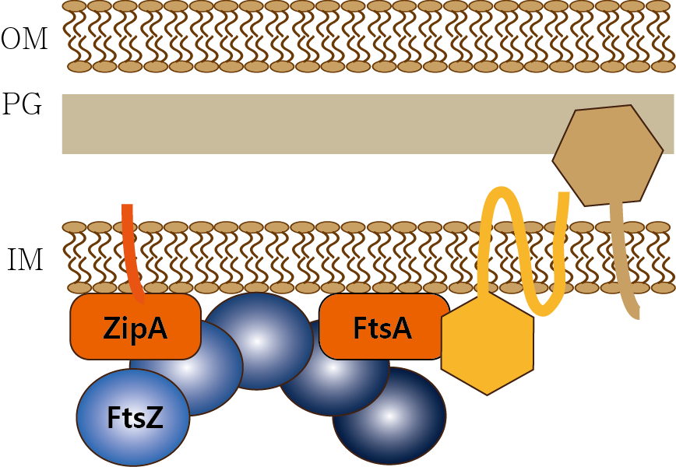
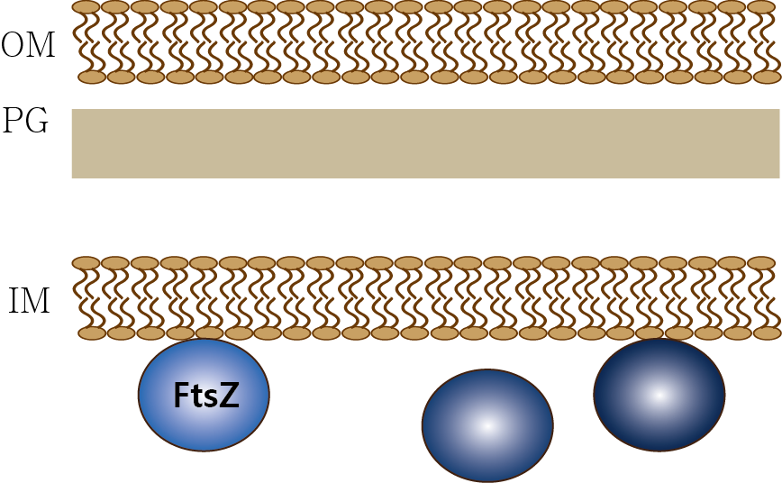
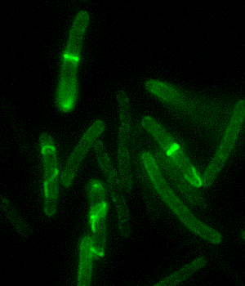
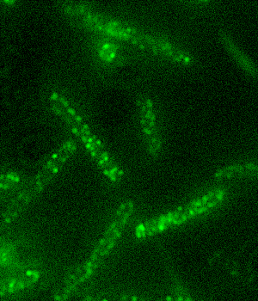
YfiN interacts with FtsZ
YfiN localization in the absence of FtsZ
ftsZ temperature sensitive mutant
30°C
42°C
FtsZ
localization
YfiN-GFP
YfiN-GFP
YfiN
localization

Slide 29
YfiN prevents septum formation
YfiN

Slide 30
YfiN relocates to midcell in response to envelope stress

Slide 31
YfiN promotes increased resistance to Polymixin B

Slide 32
YfiN is a bifunctional protein: DGC & division inhibitor

Slide 33
Why so many?
1. Reflection of the range of environmental stimuli sensed by different bacteria
2. The number of GGDEF and EAL proteins might be a measure of the ability to adapt to
different ecological niches?
3. How do bacteria coordinate the expression and activity of these proteins to reach appropriate
concentrations of c-di-GMP i.e. where does specificity come from?
Compartmentalization
Affinity
PleD / YfiN

