Slide 1
Two-Component Signal Transduction

Slide 2
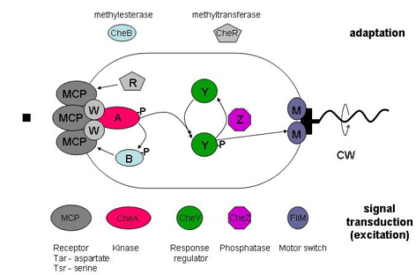
A Two-Component System is a Key Part of the Chemotaxis System

Slide 3
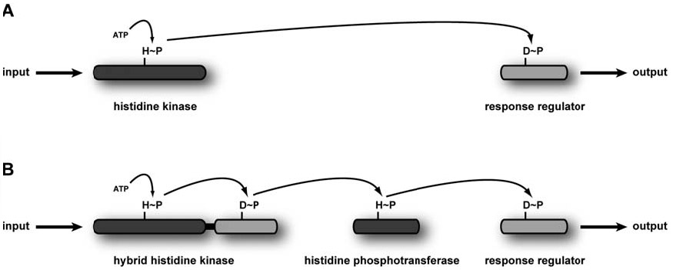
A) Schematic of the canonical two-component signaling system.
the sensor histidine kinase uses ATP to autophosphorylate. The phosphoryl group is then transferred to a cognate response regulator to trigger an output.
(B) Schematic of a phosphorelay.
the hybrid histidine kinase will transfer the phosphoryl group to a response regulator-like domain. A histidine phosphotransferase then shuttles the phosphoryl group to a soluble response regulator that affects an output.

Slide 4
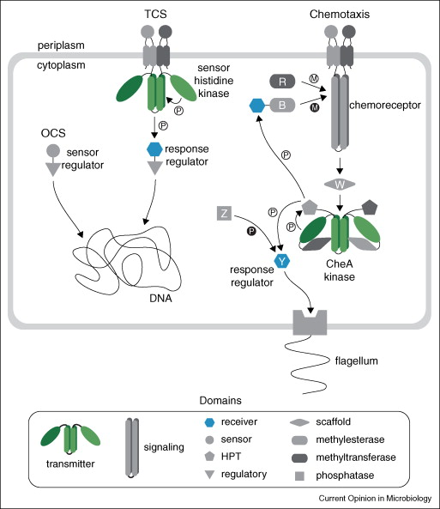
3 Major Prokaryotic Signal Transduction Paradigms
2
3
1
Wuichet et al 2010

Slide 5
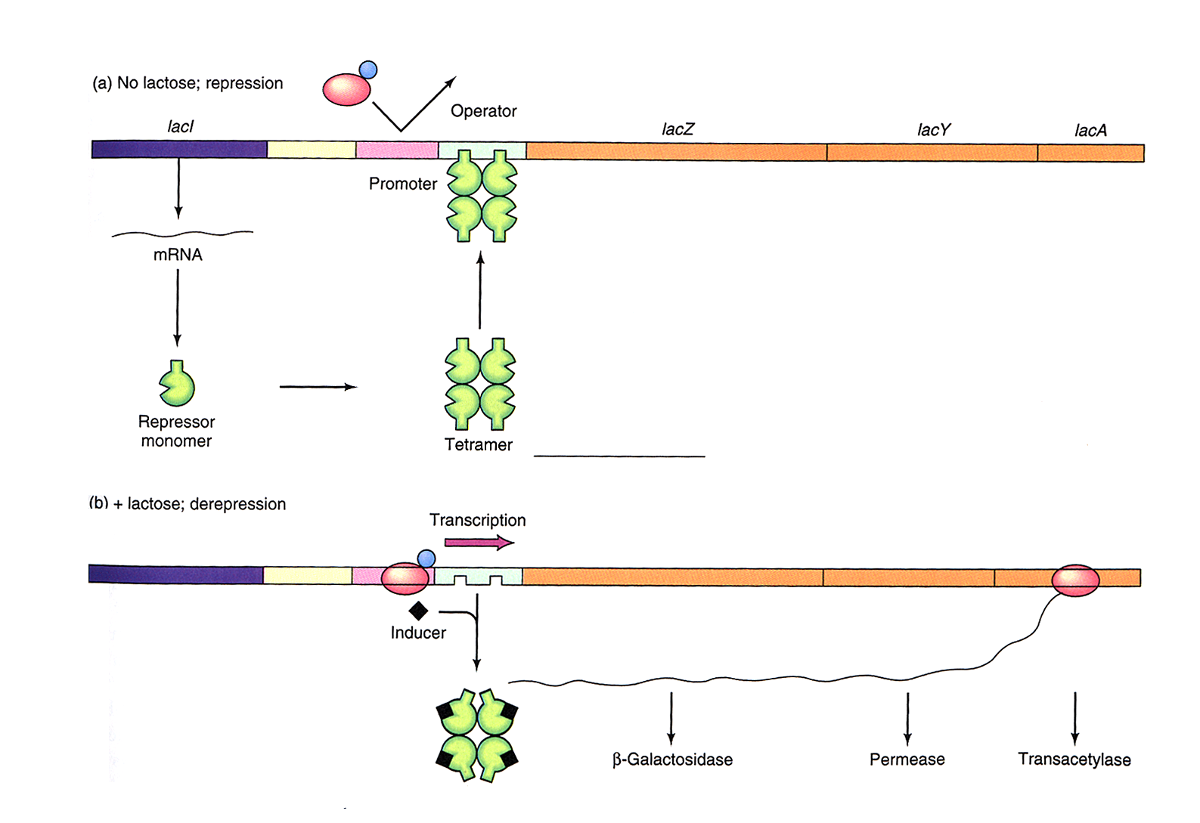
The Lac Operon: Negative regulation

Slide 6
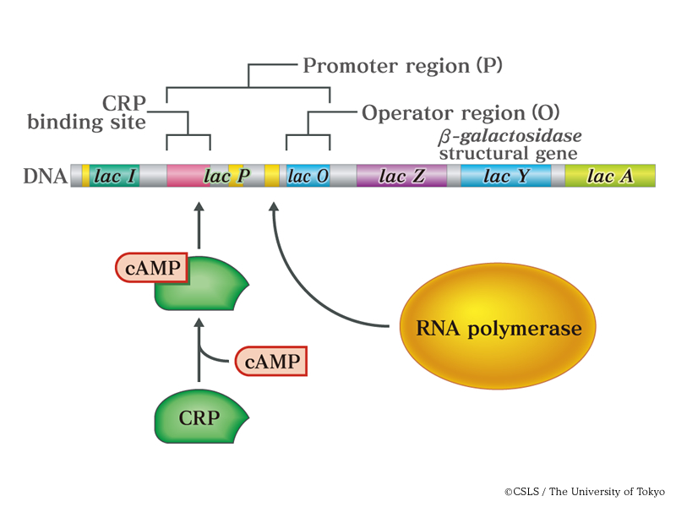
The Lac Operon: Positive regulation
Low Glucose
In both OCS examples, the sensory domain receives information about physiology through a relevant ligand

Slide 7
3 Major Prokaryotic Signal Transduction Paradigms
2
3
1
Notice the similarity of the RR to OCS
Wuichet et al 2010

Slide 8
OCS and TCS share a repertoire of input and output domains, but they differ in their sensory functionality;
OCS are know or predicted to detect signals in the cytoplasm
TCS are known or predicted to detect extracellular signals.
Extracellular sensing emerged with the advent of TCSs given that 73% of HKs are membrane associated compared to only 3% of OCSs.
* Chemotaxis being an example of non-membrane associated.
However, both OCSs and TCSs are predicted to predominantly regulate transcription.

Slide 9
Modularity of TCS Domain Architectures
The prototypical TCS employs four principal domains:
sensory and transmitter that reside in a sensor histidine kinase (HK)
and receiver and regulatory that reside in a response regulator (RR)
Many TCSs stray from this paradigm by employing additional sensory, transmitter or regulatory domains, as well as intermediate components that extend phosphorelays

Slide 10
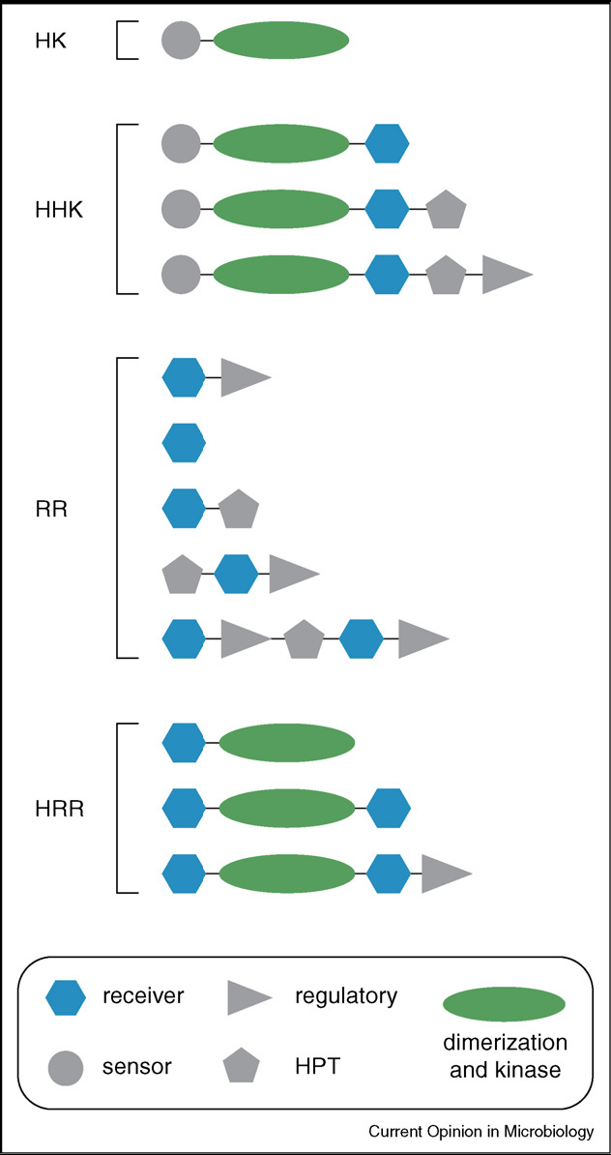
Modularity of TCS Domain Architectures
Sensor kinases with C-terminal receiver domains are referred to as hybrid histidine kinases (HHK)
Similarly there are also hybrid response regulators (HRR) with C-terminal HK modules rather than typical output domains
HHKs and HRRs are ubiquitous, but still far outnumbered by HKs and RRs with standard architectures.
HPT domains can both receive phosphoryl groups from and transmit them to receiver domains.
The modular nature of these domains leads to a variety of architectures, resulting in diverse phosphorelay pathways

Slide 11
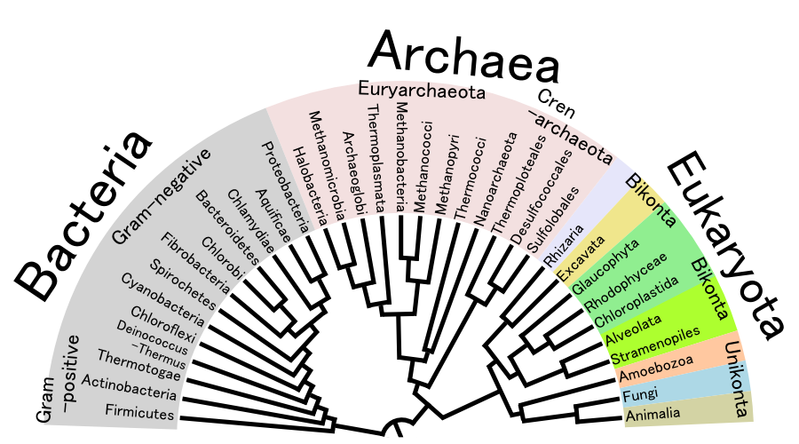
A genomic survey shows that TCSs are found in all three superkingdoms: Bacteria, Archaea, and Eukarya.
Phylogenetic analysis indicates that TCSs originated in Bacteria and were radiated to Archaea and Eukarya via multiple lateral transfer events.
It is clear that the majority arose by gene duplications of ancestral systems to acquire new input and output specificities.
Wuichet et al 2010

Slide 12
Despite the large number of sequenced bacterial genomes, only Mycoplasmas have so far been found to lack TCST systems, and these are obligate pathogens known to have greatly reduced their gene complement.
Among the Archaea, of the sequenced genomes, half lack TCST proteins.
Among eukaryotes, TCST proteins are limited to fungi, slime molds, and plants.
Thus far, no representatives have been found in animals or protists

Slide 13
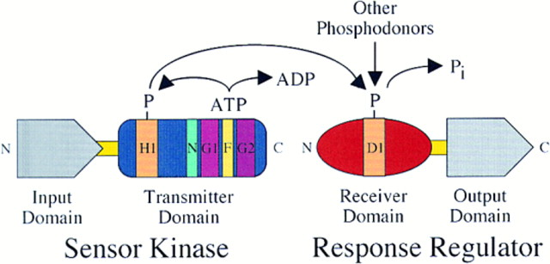
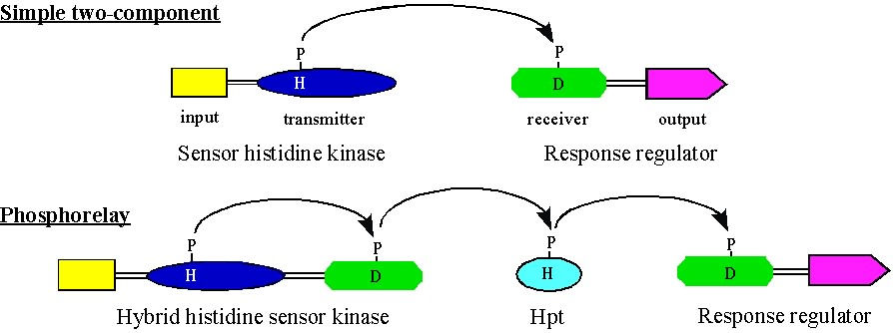
A Prototypical Two-Component Regulatory System
Appleby et al., Cell , 1996

Slide 14
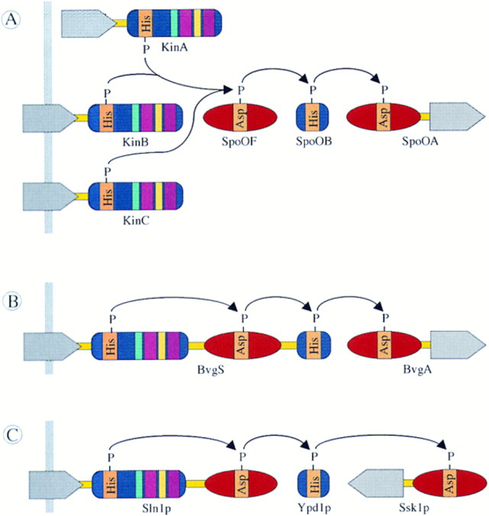
His-Asp Phosphorelays
B. subtilis sporulation
B. pertussis virulence
S. cerevisiae osmoregulation

Slide 15
Why H-D?
The H and D modules are presumably designed to recognize and dock with one another during phosphotransfer; the complementary shapes of the H and D modules would most likely preclude D-D and H-H transfers.
Why Phosphorelays?
Regulation? One possibility is that the intermediate steps in phosphorelays provide additional points of control. This is the case for the sporulation phosphorelay. Several phosphatases act at various points to provide additional inputs and multiple levels of regulation to control the switch between sporulation and alternative cell fates.
(See Fig. 2A in the Laub review)

Slide 16
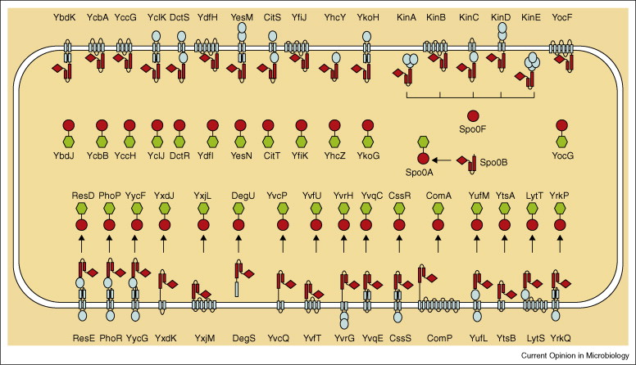
29 TCS pathways in B. subtilis: no cross-talk
Szurmant and Hoch, 2010
E. coli has 66 TCS pathways: no cross-talk

Slide 17
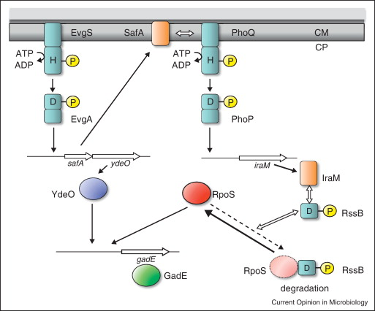
Interconnectivity of TCS networks: Acid stress adaptation in E. coli
Mg++
Low pH
Turns on acid-response
genes to neutralize pH
Combinational sensing by several TCSs enables integration of multiple stimuli
and amplification of signals, while ensuring signaling fidelity
Jung et al. 2012

Slide 18
Two-component systems regulate diverse responses including:
nutrient acquisition : nitrogen, phosphorus, carbon
energy metabolism : electron transport systems, uptake and catabolic machinery
adaptation to physical or chemical aspects of the environment : chemotaxis, pH, Mg osmolarity, light quality
complex developmental pathways: sporulation, fruiting body development, swarmer cell production
virulence : plasmid transfer (conjugation), degradative secretions, toxin production
Quorum sensing: light production, secretion of degradative enzymes, surfactants

Slide 19
With so many stresses (signals), and so many TCSs,
how does a cell make an informed choice?

Slide 20
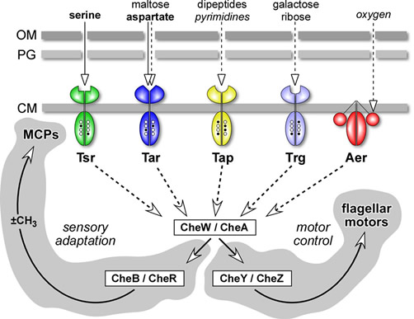
1. Chemotaxis - Multiple sensors acting on a single response regulator:

Slide 21
2. Sporulation in B. subtilis: Multiple kinases acting on a single RR
Phosphatases can interrupt phosphoryl flow
Vegetative growth
Stress
The Kin proteins exhibit sequence similarity in the residues surrounding the phosphorylatable histidine residue that will donate the phosphoryl group to the conserved aspartatyl residue in Spo0F, but differ in their putative sensing domains, indicating that they respond to different ligands or conditions.
RapA and SpoOE are phosphatases that ensure that sporulation does not occur during vegetative growth.
Bijlsma & Groisman, 2003

Slide 22
3. Multiple signals, Multiple TCS, One response
LPS modf. and Capsule prod.
The ugd gene is necessary for the PmrA-controlled modification of the lipopolysaccharide and the RcsB-dependent production of the colanic acid capsule.
The presence of distinct binding sites for the PmrA and RcsB response regulators in the ugd promoter allows for two different signals to activate the ugd gene independently.
Bijlsma & Groisman, 2003

Slide 23
3. Multiple signals, Multiple TCS, One response
LPS modf. and Capsule prod.
PmrD activates PmrA/B system post-transcriptionally. PmrD is transcribed in response to the low Mg2+ signal via PhoP/B.
Thus, even in the absence of Fe3+, which is the specific signal sensed by the PmrB protein, ugd, like other PmrA-activated genes, is expressed in response to the low Mg2+ signal. By contrast, the PmrD protein is not required for the Fe3+-promoted activation of the PmrA/PmrB system.
Thus, Salmonella expresses PmrA-regulated gene products independently in response to two signals – high Fe3+ and low Mg2+.
Bijlsma & Groisman, 2003

Slide 24
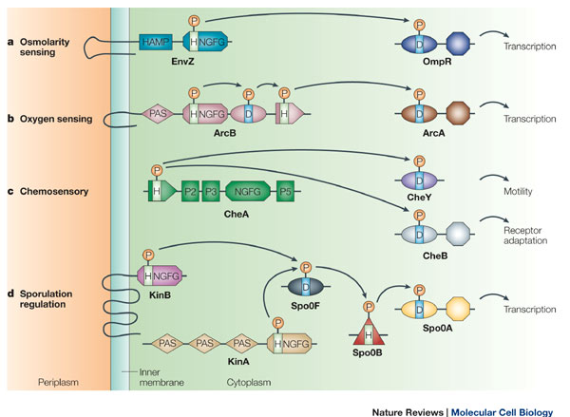
HAMP & PAS domains
Microaerophilic genes
Aer
PAS
MCP
HAMP

Slide 25
PAS domains: found in a large number of organisms from bacteria to humans. Named after the three proteins in which it occurs:
Per – period circadian protein
Arnt – aryl hydrocarbon receptor nuclear translocator protein
Sim – single-minded protein
Many PAS-domain proteins detect their signal by way of an associated cofactor such as heme and FAD.
PAS proteins are always located intracellularly but may monitor the external as well as the internal environment, one example being the electron transport system. This serves as an early warning system for any reduction in cellular energy levels.

Slide 26
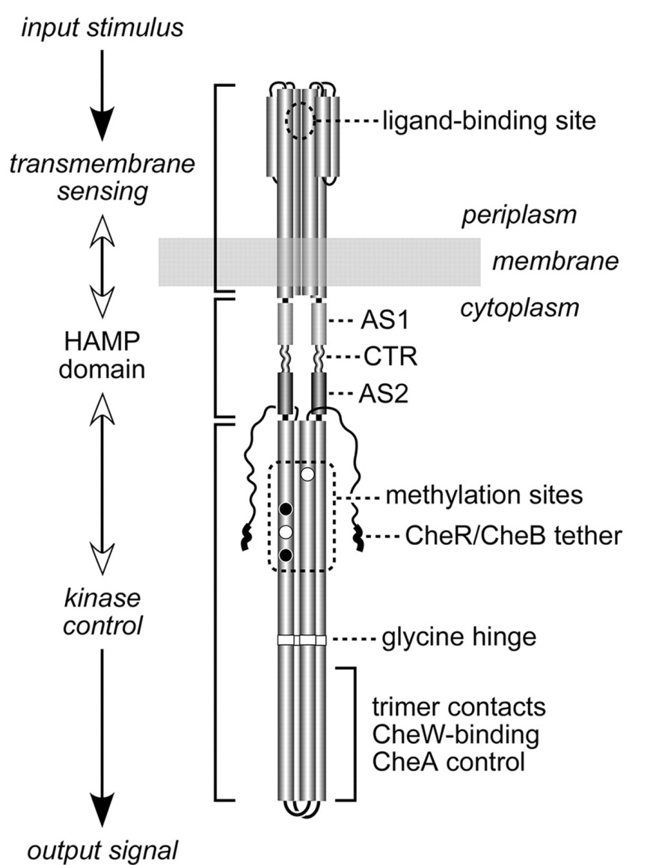
HAMP is a linker domain found in:
Histidine kinases
Adenylate cyclases,
Methyl accepting proteins
Phosphatases

Slide 27
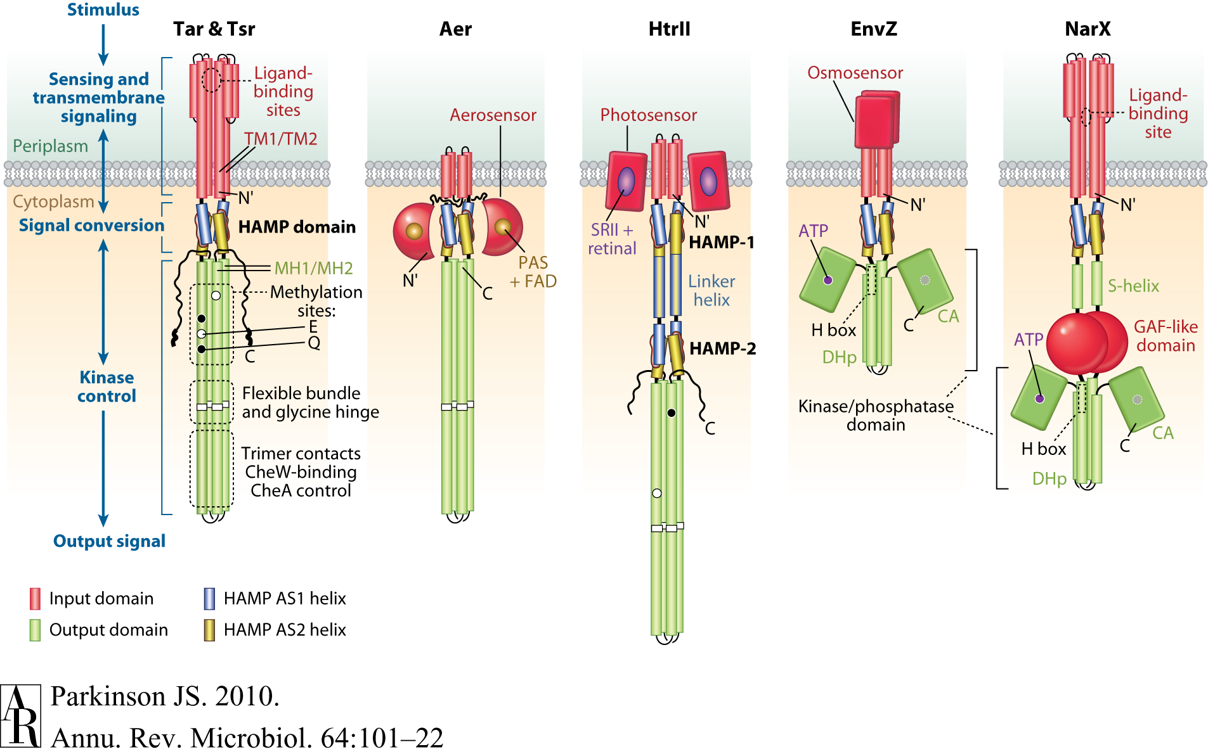
HAMP & PAS domains
GAF is named after domains found in:
cGMP-specific phosphodiesterases
Adenylyl cyclases and
FhlA

Slide 28
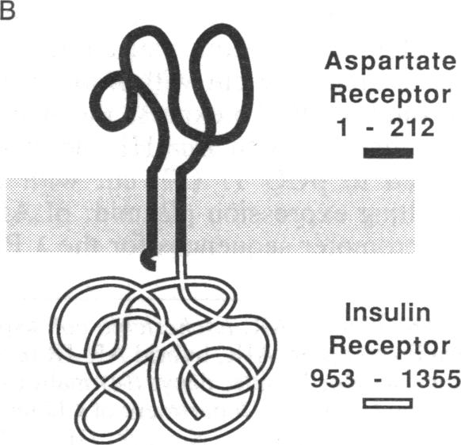
Hybrids reveal conserved motion across membrane
Tar – IR hybrid
This chimeric receptor is active as a tyrosine kinase, and aspartate stimulates its activity. The only similarity between the two proteins is their TM regions.
Moe GR et al. PNAS 1989

Slide 29
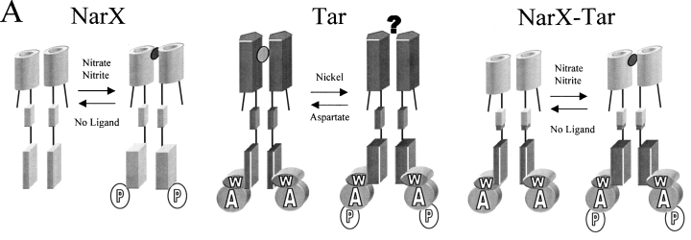
NarX-Tar hybrid
Nitrates stimulate CheA autophosphorylation
Ward et al. 2002

Slide 30
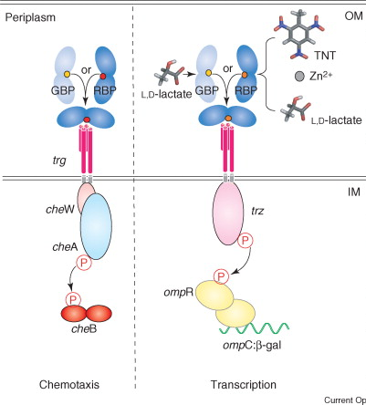
TrZ / TaZ hybrids

Slide 31
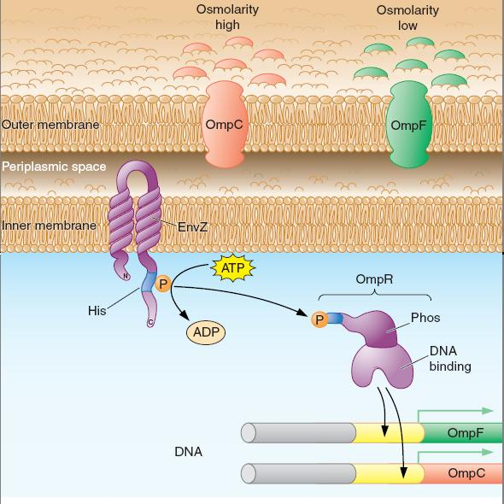
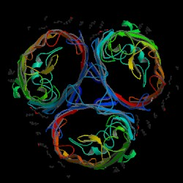
EnvZ/OmpR Porin Regulation
High OS
OmpF – larger porin

Slide 32
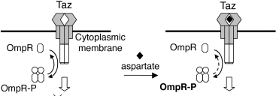
Domain swapping
Much of the work to date has focused on manipulation of transcriptional and post-transcriptional elements to create synthetic gene networks with desired functions.

Slide 33
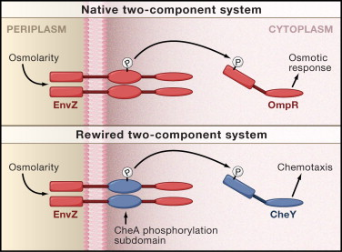
Rewiring a bacterial TCS
Kohanski & Collins, Cell 2008

